Slide 1
A Web service is seen as an application accessible to other applications over the Web . This is a very open definition, under which just about anything that has a URL is a Web service.
A more precise definition is provided by the UDDI consortium, which characterizes Web services as "self-contained, modular business applications that have open, Internet-oriented, standards-based interfaces". This definition is more detailed, placing the emphasis on the need for being compliant with Internet standards.

Slide 2
World Wide Web consortium (W3C), and specifically the group involved in the Web Service Activity: "a software application identified by a URI, whose interfaces and bindings are capable of being defined, described, and discovered as XML artifacts. A Web service supports direct intimations with other software agents using XML-based messages exchanged via Internet-based protocols“.
The definition stresses that Web services should be capable of being "defined, described, and discovered," thereby clarifying the meaning of "accessible" and making more concrete the notion of "Internet-oriented, standards-based interfaces."

Slide 3
Web services are components that can be integrated into more complex distributed applications.
in the online technical dictionary Webopedia, a Web service is defined as "a standardized way of integrating Web-based applications using the XML, SOAP, WSDL, and UDDI open standards over an Internet protocol backbone. XML is used to tag the data, SOAP is used to transfer the data, WSDL is used for describing the services available, and UDDI is used for listing what services are available" .

Slide 4
Web Services Architecture
There are two different aspects to be considered when analyzing Web services architectures. The first aspect is related to the fact that Web services are a way to expose internal operations so that they can be invoked through the Web.
Such an implementation requires the system to be able to receive requests through the Web and to pass them to the underlying IT system. In doing this, the problems are analogous to those encountered in conventional middleware.
We will refer to such an infrastructure as internal middleware for Web services. Correspondingly, we will use the term internal architecture to refer to the organization and structure of the internal middleware.

Slide 5
The other facet of Web services architectures is represented by the middleware infrastructure whose purpose is to integrate different Web services.
Web Services will refer to such an infrastructure as external middleware for Web services .
Correspondingly, we will use the term external architecture to refer to the organization and structure of the external middleware.
The external architecture has three main components:

Slide 6
Centralized brokers. These are analogous to the centralized components in conventional middleware that route messages and provide properties to the interactions (such as logging, transactional guarantees, name and directory services, and reliability). However, as we will see, in practice the name and directory server is often the only centralized component present in Web services architectures.
• Protocol infrastructure. This refers to the set of components that coordinate the interactions among Web services and, in particular, implement the peer-to-peer protocols (such as the horizontal protocols and the meta protocols discussed in the previous section) whose aim is to provide middleware properties in those B2B settings where a centralized middleware platform cannot be put in place due to trust and privacy issues.
• Service composition infrastructure. This refers to the set of tools that support the definition and execution of composite services

Slide 7
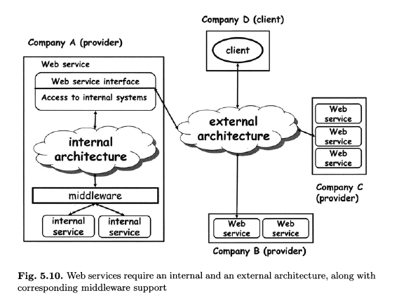

Slide 8
There are Web services technologies and products that take care solely of the internal architecture of a Web service.
There are also technologies and products that address only the external architecture of a Web service. Standardization efforts, however, mainly revolve around the external architecture.
In practice both the internal and the external architecture must work together so that a Web service can make its functionality accessible to client.

Slide 9
In EAI, conventional middleware is used to build multi-tier architectures. In these architectures, individual programs or applications are hidden behind service abstractions that are combined into higher order programs or applications by using the functionality provided by the underlying middleware.
The resulting higher order programs can in turn be hidden behind new service abstractions and can be used as building blocks for new services.

Slide 10
Web services or, better, the technologies supporting Web services, play the same role as conventional middleware, but on a different scale. The basis for composition is service abstractions very similar in nature to those used in conventional middleware, so that implementing a Web service essentially requires an extra tier on top of the others to enable access using standard Web services protocols

Slide 11
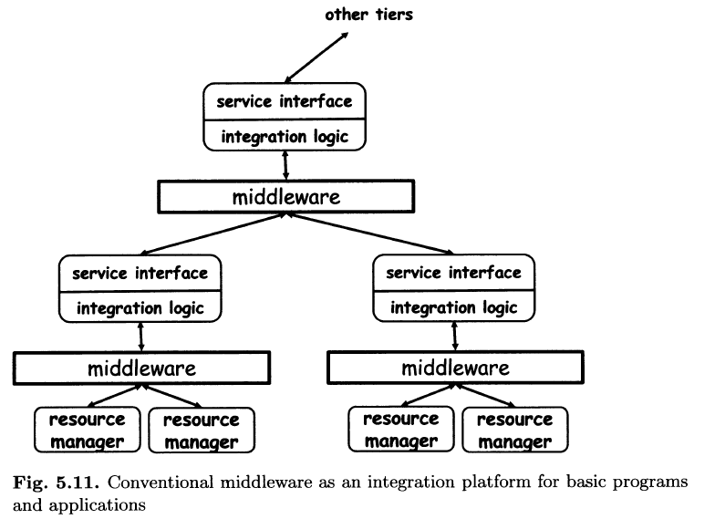

Slide 12
The implementation does not occur at the Web services layer, but within conventional middleware.
As observed earlier, Web services are just wrappers. They invoke internal
services that implement whatever application logic is needed, and then collect
the results.
Today, much of the internal middleware for Web services revolves around packing and unpacking messages exchanged between Web services and converting them into the format supported by the underlying middleware.

Slide 13
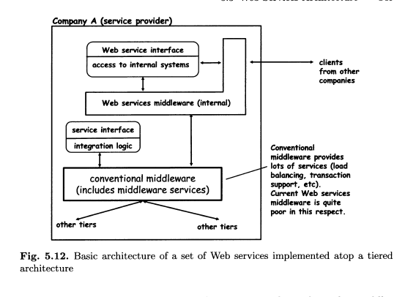

Slide 14
In Web services, the parties can reside in different locations, and
there is therefore no obvious place where to locate the middleware.
There are two solutions to this problem. One is to implement the middleware as a peer-to-peer system where all participants cooperate to provide name and directory services. Conceptually, this is a very appealing approach, but it is not obvious how to provide the degree of reliability and trustworthiness required in industrial strength systems.
The other solution is to introduce intermediaries or brokers acting as the necessary middleware. Assuming we find a site somewhere in the network that we can trust and that is reliable enough, the site could act as a name and directory server for Web services.
Currently, there is only one type of Web services broker that has been standardized and that is used in practice, although to a very limited extent:the name and directory server.

Slide 15
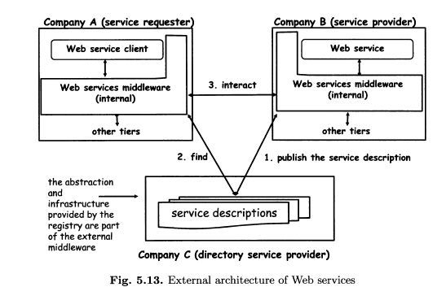

Slide 16
The idea is for service providers to create Web services and to define an interface for invoking them. The service provider also has to generate service descriptions for those services.
The service provider will then make its services known to the world by publishing the corresponding service descriptions in a service registry.
When a service requester tries to find a service, it queries the service registry.
The service registry answers with a service description that indicates where to locate the service and how to invoke it.
The service requester can then bind to the service provider by invoking the service. The directory itself is very likely available as a Web service, whose address and interface are assumed to be known a priori by the requester.
Service composition tools are another ingredient of external Web service
architectures, likely to gain more importance as technology matures.
We consider composition as part of the external architecture since it is about the integration of other Web services.

Slide 17
Processing a SOAP Message
The division between header and body already provides some indication of how SOAP expects messages to be processed by the different nodes along themessage path. These nodes will, in most cases, constitute the different tiers ofthe Web services middleware.
In the SOAP model, nodes processing a message can play one or more roles. Each block in a SOAP header may include the definition of the role for which it is intended.
The SOAP specification defines three roles, informally called none, next, and ultimateReceiver:

Slide 18
If a block is assigned to a none role, it means that such a block should not be processed by any node receiving the message (although the block might be read if it contains information important for processing other blocks).
• If a block is assigned to the ultimateReceiver role, that block is solely intended for the recipient of the message, not for any intermediate node.
If a block is assigned to the next role, every node receiving the message can process that block. This is because every node receiving a message is the "next" one in the chain of nodes processing the message. The ultimateReceiver is also included in the set of next nodes.

Slide 19
The body of the message does not have a role associated to it. Its role defaults to ultimateReceiver.
Processing a block may encompass very different operations, and each node involved in the processing could do something different. For example, processing can involve removing blocks from the header, performing some action(such as logging the message), extending the header with additional information,removing the header and introducing a new one, and more.

Slide 20
A block may contain a must Understand flag, indicating that a node playing the role indicated by the block must process the block.
If the flag is set and, for some reason, the node cannot process the block as needed, any further processing of that message stops and a fault is generated. The message is not forwarded to any other node.
If the must Understand flag is not set or is absent, a node is free to decide whether to process or ignore the block (assuming it has the corresponding role).

Slide 22
Structure and Contents of a SOAP Message
SOAP exchanges information using messages. These messages are used as an envelope where the application encloses whatever information needs to be sent.
Each envelope contains two parts: a header and a body (Figure 6.4). The header is optional, that is, it may or may not be present in a SOAP message.
The body is mandatory, i.e., all SOAP messages must have a body.

Slide 23
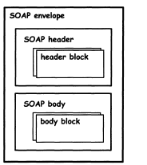
Both header and body can have multiple sub-parts in the form of header blocks or body blocks.

Slide 24
SOAP assumes that every message has a sender, an ultimate receiver, and an arbitrary number of intermediaries (called nodes) that process the message and route it to the receiver.
The core of the information the sender wants to transmit to the receiver should be in the body of the message.
Any additional information necessary for intermediate processing or added value services (like transactional interaction, security, etc.) goes into the header

Slide 25
The header contains information that can be processed by intermediate nodes. The payload or body is the actual message being conveyed.
This is the reason why the header is optional. If there are no intermediaries in a SOAP transmission, the header might not be necessary at all.
If there are intermediaries, they will work with the information in the headers as the need dictates (processing the header, adding new headers, keeping track of the message, etc.)

Slide 26
SOAP does not require any further structure within the content placed in header or body blocks. Nevertheless, there are a few common ways in which the header and body are constructed, and these are likely to become accepted forms.
Typically, there are two aspects that influence how the header and body of a SOAP message are constructed: interaction style and encoding rules.

Slide 27
Broadly speaking, SOAP can be used in two interaction styles: document-style and RPC-style.
In document-style interaction, the two interacting applications agree upon the structure of documents exchanged between them. SOAP messages are used to transport these documents from one application to the other.

Slide 28
In RPC-style interaction, one SOAP message encapsulates the request while another message encapsulates the response, just as in document-style interaction.However, the difference is in the way these messages are constructed.
The body of the request message contains the actual call. This includes the name of the procedure being invoked and the input parameters.
The body of the response message contains the result and output parameters.

Slide 29
If there are additional properties associated with the RPC call, they are expressed in the header.
Thus, if the RPC is going to be transactional, the header would include the necessary transactional context for the receiving site to process the request transactionally.
The document-style interaction involves the client sending a PurchaseOrder document and the supplier responding with an Acknowledgement document.fig given below

Slide 30
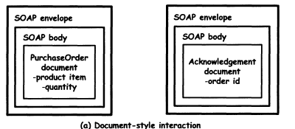

Slide 31
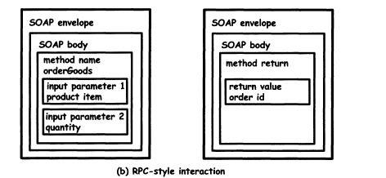

Slide 32
In the above diagram ,The RPC-style interaction involves the client making a orderGoods method call using a SOAP message and the supplier responding with a order id as the return value in another SOAP message

Slide 33
The structure of a SOAP message is also influenced by encoding rules,which define how a particular entity or data structure is represented in XML.
For example, a product item can be represented in several ways, some of which are shown in Figure 6.6. In order for the client and server to interoperate, it is essential that they agree on how the contents of a SOAP message are encoded.
SOAP 1.2 defines a particular form of encoding called SOAP encoding.
This defines how data structures including basic types such as integers and strings as well as complex types such as arrays and structures can be serialized into XML.

Slide 34

Fig. 6.6. Different encodings result in different XML structures in a SOAP message

Slide 35
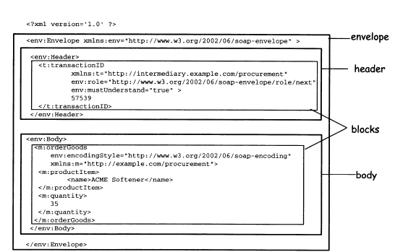
An example of a SOAP message with a header block that is intended for processing by an intermediary

Slide 36
Goals of WSDL
The Web Services Description Language (WSDL) has a role and purpose similar to that of IDLs in conventional middleware platforms.
In WSDL,specifications are XML documents that describe Web services, and in particular describe service interfaces.
In a nutshell, this is what WSDL is about. However, from an IDL perspective, the problems in Web services are more complex than in conventional middleware.

Slide 37
The problems caused by the lack of a centralized middleware, WSDL also needs to cope with the higher complexity of Web services, and in particular with the fact that interactions are often asynchronous. Conventional IDLs are typically used to describe a single entry point to a service (a single RPC interaction). As we have seen in the previous chapter.
The invocation of a Web service typically involves the exchange of several asynchronous messages between requesters and providers. To support these needs, WSDL includes a collection of different interaction paradigms, along with the ability to combine operations or groups of operations within an interface

Slide 38
Structure of WSDL
To address the above-mentioned problems, WSDL specifications are often characterized by an abstmct part, conceptually analogous to conventional IDL,and a concrete part, that defines protocol binding and other information (Figure 6.10).
The abstract part is made of port type definitions, which are analogous to interfaces in traditional middleware IDLs. Each port type is a logical
collection of related operations.

Slide 39
Each operation defines a simple exchange of messages. As described in the previous section, a message is a unit of communication with a Web service, representing the data exchanged in a single logical transmission.
As in the case of other Web services standards, these constructs are all defined in XML.

Slide 40
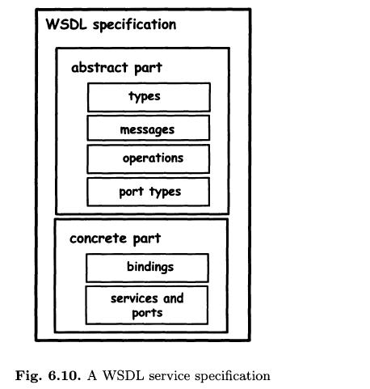

Slide 41
As with any IDL, WSDL needs a type system so that the data being exchanged can be correctly interpreted at both ends of the communication.
By default, WSDL uses the same type system as XML Schemas, although the WSDL document can specify a different type system if necessary.

Slide 42
XML Schemas have built-in basic data types and allow users to define more complex data types such as structures.
So, the first step in defining a WSDL interface is to identify and define all the data structures that will be exchanged as parts of messages between applications.
The second step is to define messages that build on such data structures.
In WSDL, each message is a typed document divided into parts. Each part is characterized by a name and by a type, referring to a type typically defined in XML schema.

Slide 43
The third step in defining a WSDL interface is to define operations, also called transmission primitives or interactions. There are four basic operations:
one-way, request-response, solicit-response, and notification.

Slide 44
One-way and notification operations involve a single message. In one-way interaction, the client invokes a service by sending a message. In notifications, it is the service thatsends the message.
Request-response and solicit-response involve the exchange of two messages. The former is initiated from outside the service (the service is invoked and a response follows).
The latter is started by the service itself (the service makes a request and expects a response in return).

Slide 45
Synchronous interactions are defined using request-response or solicit-response operations, while asynchronous interactions are defined using one-way and notification operations.
The final step in defining an abstract WSDL interface is to group operations into port types. WSDL 1.2 allows a port type to be extended from other port types.
In such cases, the port type contains all of the operations from the port types it extends, along with any other operations it defines.

Slide 46
The concrete part of a WSDL interface is defined using the following three constructs
InterfaceBindings. The binding specifies the message encoding and protocol bindings for all operations and messages defined in a given port type.For instance, it could specify that an operation is an RPC-style operation or a document-style operation.
Given that the communications protocol is SOAP, the main available transport binding options are HTTP and SMTP.

Slide 47
An InterfaceBinding also specifies the encoding rules that should be used in serializing the parts of a message into XML
There are usually two possible encodings-literal and SOAP. Literal encoding takes the WSDL types defined in XML Schemas and "literally" uses those definitions to represent the XML content of messages.
In other words, the abstract WSDL types also become concrete types.
SOAP encoding, on the other hand, takes the XML Schema definitions as abstract entities, and translates them into XML using SOAP encoding rules defined as part of SOAP 1.2.
Typically, literal encoding is used for document-style interactions whereas SOAP encoding is used for RPC-style interactions.

Slide 48
Ports. Also known as Endpoints, ports combine the InterfaceBinding information with a network address (specified by a URI) at which the implementation of the port type can be accessed.
Again, this is not needed in conventional middleware due to the presence of a centralized infrastructure that manages addresses in a transparent manner.

Slide 49
Services. Services are logical grouping of ports. Note that, at least in principle, this also means that a specific WSDL service could be available at different Web addresses.
In practice, however, it is likely that a WSDL service will group related ports, typically available at the same address.

Slide 50
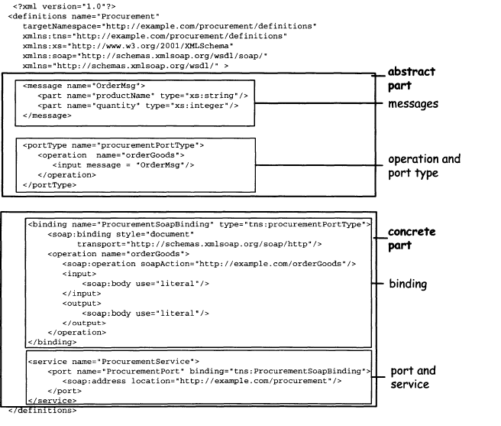
A WSDL service specification

Slide 51
Implications of the WSDL Model
The WSDL data structure has interesting implications on how services are described and how they interact. One of them is related to the different operation types.
In fact, the interaction modes that can be associated with a WSDL operation show that, unlike IDLs in conventional middleware, a service can proactively initiate the interaction.
In other words, it not only exposes operations that can be invoked, but also operations that invoke, meaning that a service can also behave like a client.

Slide 52
This leads to a further blurring of the notion of clients and service providers.
Another implication of the data structure specification is that WSDL does not presume that exchanges will take place using a particular form of communication.
This is why WSDL can be used to describe two aspects of a Web service, as depicted in Figure The first is the abstract interface of the service, without specifying the location or the protocol to be used.
The second is the actual location of the service and the communication protocol to be used.

Slide 53
The advantage of this separation is that WSDL specifications that describe abstract interfaces are reusable: different services could combine different interfaces using different bindings, and could make them available at different addresses.
Note also the correlation of the WSDL description with SOAP. If the messages defined in WSDL are exchanged using SOAP, then the InterfaceBindings contain all the information needed to infer or automatically construct the SOAP messages.

Slide 54
UDDI: Universal Description Discovery and
Integration(goals)
The primary goal of UDDI is the specification of a framework for describing and discovering Web services. The core of UDDI revolves around the notion of business registry, which is essentially a sophisticated naming and directory service.
In particular, UDDI defines data structures and APIs for publishing service descriptions in the registry and for querying the registry to look for
published descriptions.

Slide 55
The UDDI registry specifications have two main goals with respect to service discovery: first, to support developers in finding information about services,so that they know how to write clients that interact with those services.
Second, to enable dynamic binding, by allowing clients to query the registry and obtain references to services of interest. This dual nature is clearly reflected in UDDI, which leaves room for both structured and unstructured information.

Slide 56
UDDI also addresses the notion of Universal Business Registry (UBR). In fact, the initial goal of the consortium was supporting worldwide directories where everybody could publish service descriptions (essentially for free) and where everybody could query these directories to find services of interest.

Slide 57
Information in a UDDI Registry
A simple way of categorizing the information contained in a UDDI registry is in terms of what each type of information is used for. This categorization is best understood by means of an analogy with the telephone directory
White pages. They are listings of organizations, of contact information(e.g., telephone or e-mail address), and of the services these organizations provide. Using the registry as a white pages catalogue, UDDI clients can find Web services provided by a given business.

Slide 58
Yellow pages. They are classifications of both companies and Web services according to taxonomies that can be either standardized or userdefined.
Through yellow pages, it is possible to search for services based on the category they belong to, according to a given classification scheme.
Green pages. This information describes how a given Web service can be invoked. It is provided by means of pointers to service description documents, typically stored outside the registry (e.g., at the service provider's site) .

Slide 59
UDDI Data Structures
In the UDDI registry, Web services descriptions contain four types of information:
business information, service information, binding information, and information about specifications of services, described by several entities.
The four main entities of the registry are described below:

Slide 60
businessEntity. It describes an organization that provides Web services.
It lists the company's name, address, and other contact information.
businessService
This element describes a group of related Web services offered by a businessEntity. Typically, a businessService will correspond actually to one kind of service (such as a procurement or a travel reservation service), but provided at different addresses, in multiple versions, and through different technologies (e.g., different protocol bindings).
Business services, like business entities, can also include classification information. A businessEntity entry can include multiple businessService elements, but a business Service belongs to one and only one businessEntity

Slide 61
bindingTemplate. This element describes the technical information necessary to use a particular Web service. Essentially, it defines the address at which the Web service is made available along with a set of detailed information, such as references to documents (called tModels) describing the Web service interface or other service properties.

Slide 62
It also defines how operation parameters should be set and the default values for such parameters.
A business Service entry can include multiple bindingTemplate elements (one for each interface or address), but a bindingTemplate belongs to one and only one businessService

Slide 63
tModel. The cryptic name stands for "technical model" , and it is a generic container for any kind of specification.
For example, it could represent a WSDL service interface, a classification, or an interaction protocol, or it could describe the semantics of an operation.
Unlike the previous entities, tModels are not subject to parent-child relationships, and can be referred to by other entities to denote conformance to an interface, or to classify businesses or services.

Slide 64
In summary, if we want to publish one or more services in a UDDr registry,we first need to define a set of tModels describing the different characteristics of the services

Slide 65
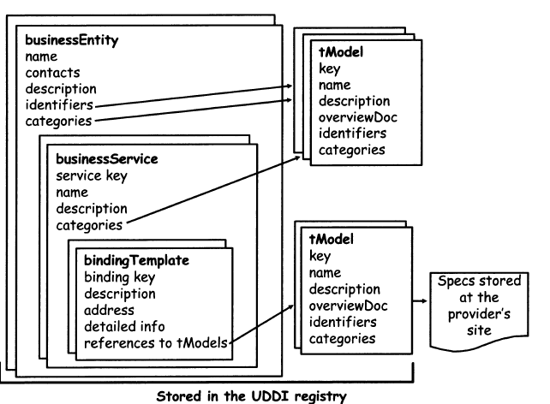
A schematic view of a UDDI registry entry

Slide 66
UDDI Registry API
UDDI registries have three main types of users to whom they expose their API:service providers that publish services, requesters that look for services, and other registries that need to exchange information.
These clients can access the registry through six sets of APIs:

Slide 67
The UDDI Inquiry API includes operations to find registry entries that satisfy search criteria and to get overview information about those entities (find_business, find_service, find_binding, find_tMode0, and operations that provide details about a specific entity (get businessDetail,
Get serviceDetail, get bindingDetail, get ModeLDetail.
This API is meant
to be used by UDDI browser tools that help developers find information
and by clients at run-time, for dynamic binding.

